Slide 1
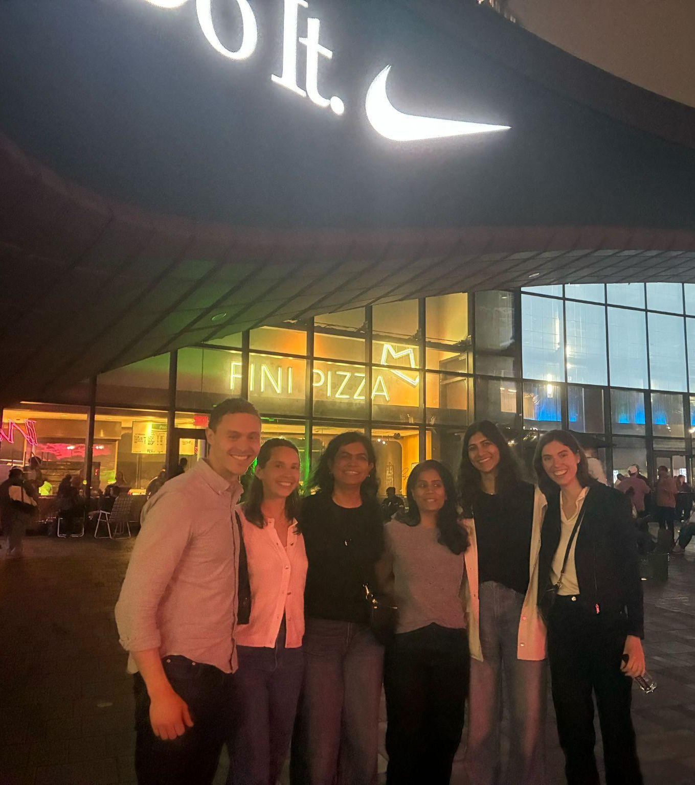
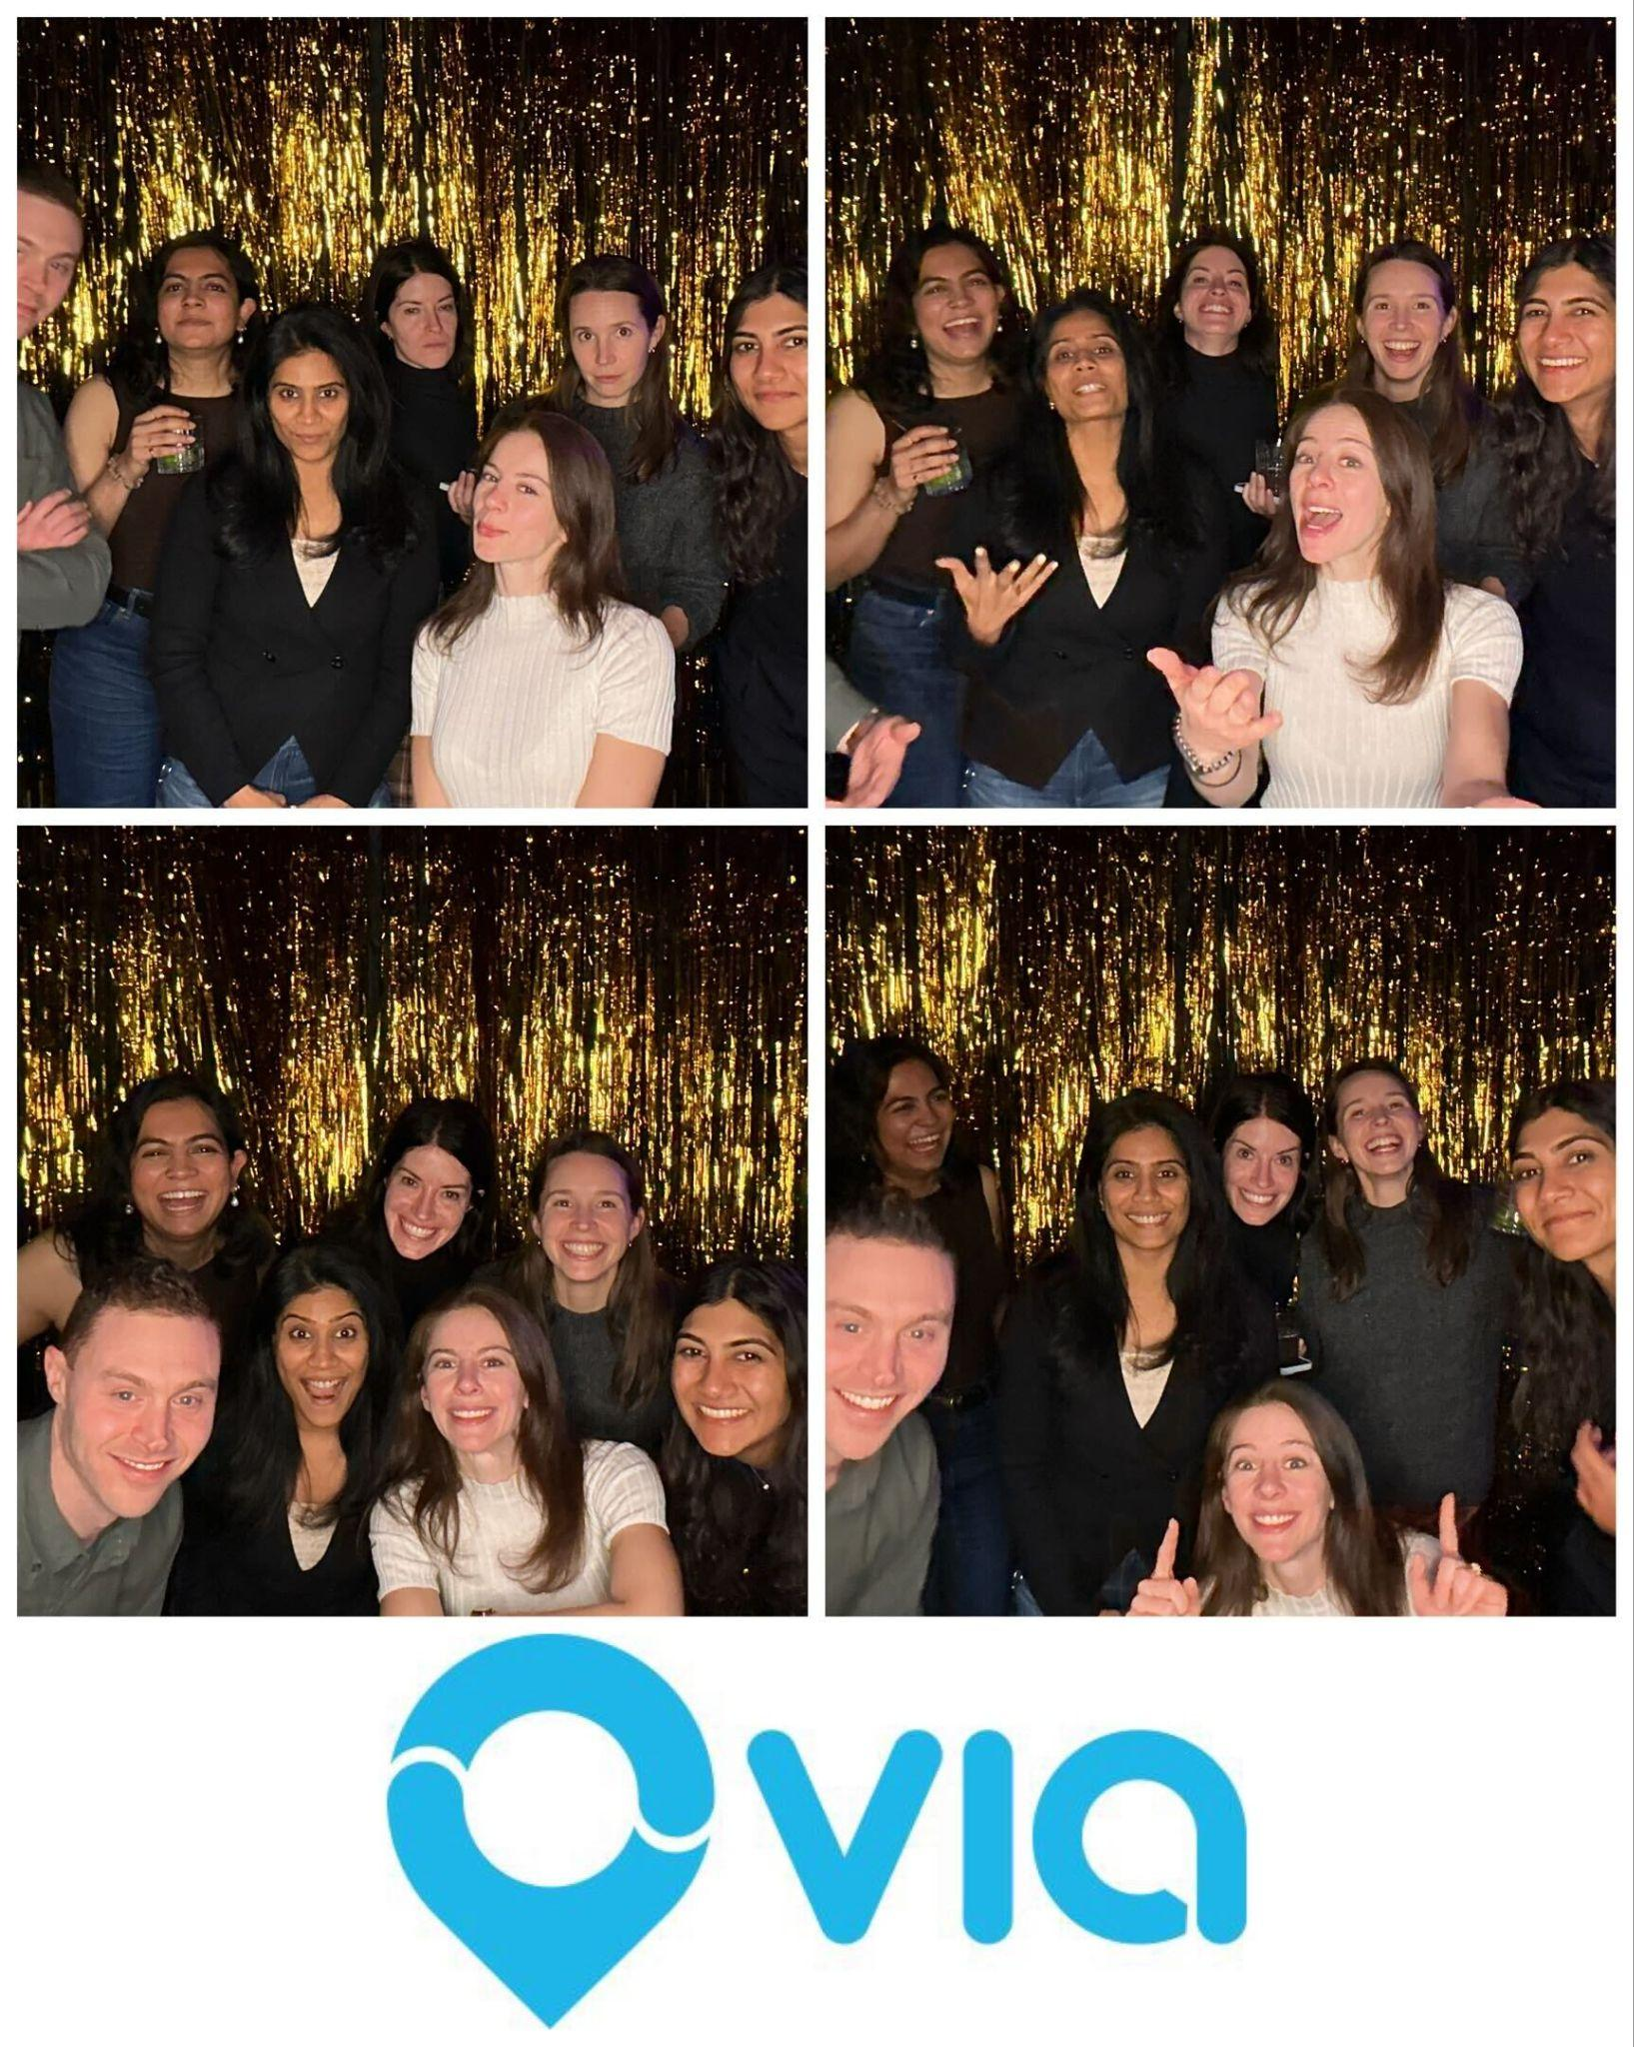
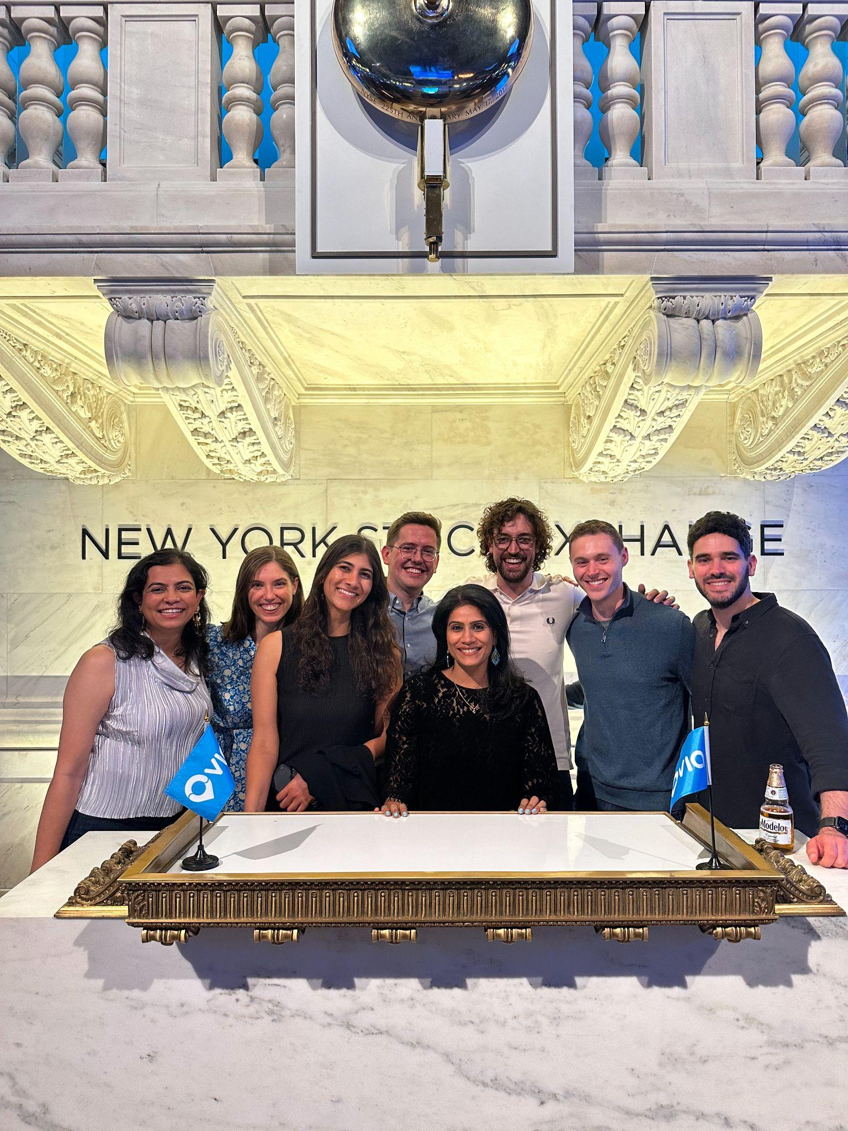
Thank you Jahan!
Wishing you well on your next adventure!

Slide 2
Jahan! You are truly such a joy to work with. Your intelligence, work ethic, and genuine openness to feedback and input make you one of those rare people who can excel at anything you set your mind to. I have complete confidence that you’ll be incredibly successful in your next role.
The team is so lucky to have you, and while I’m sad to see you leave Product, I’m very happy that you’ll still be at Via. Thank you for everything you’ve contributed during your time on the Product team. From the bookings page, payments, ride groups, to your relentless attention to detail and extreme ownership of even the smallest decisions, to pioneering our Voice AI and Long Term Assignments products — you’ve left a meaningful and lasting imprint on both the product and our users.
Thank you, Jahan!! I’m always rooting for you!
- Courtney
Jahan, it was nice having you as my seat neighbor for a little while! Thanks for still being on the Product team at heart and helping us cooperate effectively with your awesome new team :) I’m grateful for your collaborative spirit, and I have no doubt you're going to do a fantastic job in your new role!
- Jwanah

Slide 3
.
Jahan! It was an honor to have you on the Operator product team and we're so thrilled for your next adventure (where you're already thriving!).
We learned a ton from your knowledge at Via - especially about our partners and users. You made a huge impact on IVR, Booking Management, Planning, Pricing and many more products you worked on, redefining how we built product and work with Engineering and Business teams. That's no small feat in a few years! It’s also remarkable how you can jump into the most challenging projects and always figure out a solution.
Thank you for everything you've contributed to our team culture all the way to your last day (and beyond!), making sure everyone was set up for success.
We miss having you in Product, but relieved we continue to work with you and Delivery Ops - making our teams more connected than ever! Wishing you all the best and can’t wait to cheer you on.
- Jared
Jahan, you had a massive impact in a short amount of time from launching a new Bookings page to correcting error messages to helping us change critical payment infra. There’s no task too small or big for you and Product and all of us in the org are better for you having been in it.
Good luck and just keep lurking in our channels and coming to our 4 pm (3? 2? 1?) happy hours!
- Nithya

Slide 4
Jahan, a Via legend! 🐐🐐🐐
Thanks for shepherding me through my first few months at Via & in NYC, I would have been lost without your support, friendship, and VOC expertise. Your impact on the team and our product is still extremely evident, and it’s been a joy to think through and work together on all the different thorny problems we’ve come across.
I’m so excited to see you thrive in your new role, and bring product & delivery closer together.
Our next Liberty game outing will have to be a DelOps x Product special!!
– Varsha
Jahan! I learned so much about the Via product from you - before you joined our team officially and even more once you did! Thank you for being such a great thought partner in brainstorming about paratransit features. You made quite an impact on our team and the VOC in your time on product, and we’ll miss you! That said, I’m excited for you and your new role and know that you will absolutely crush it. Good luck, and keep visiting us for lunches and happy hours!
- Lauren

Slide 5
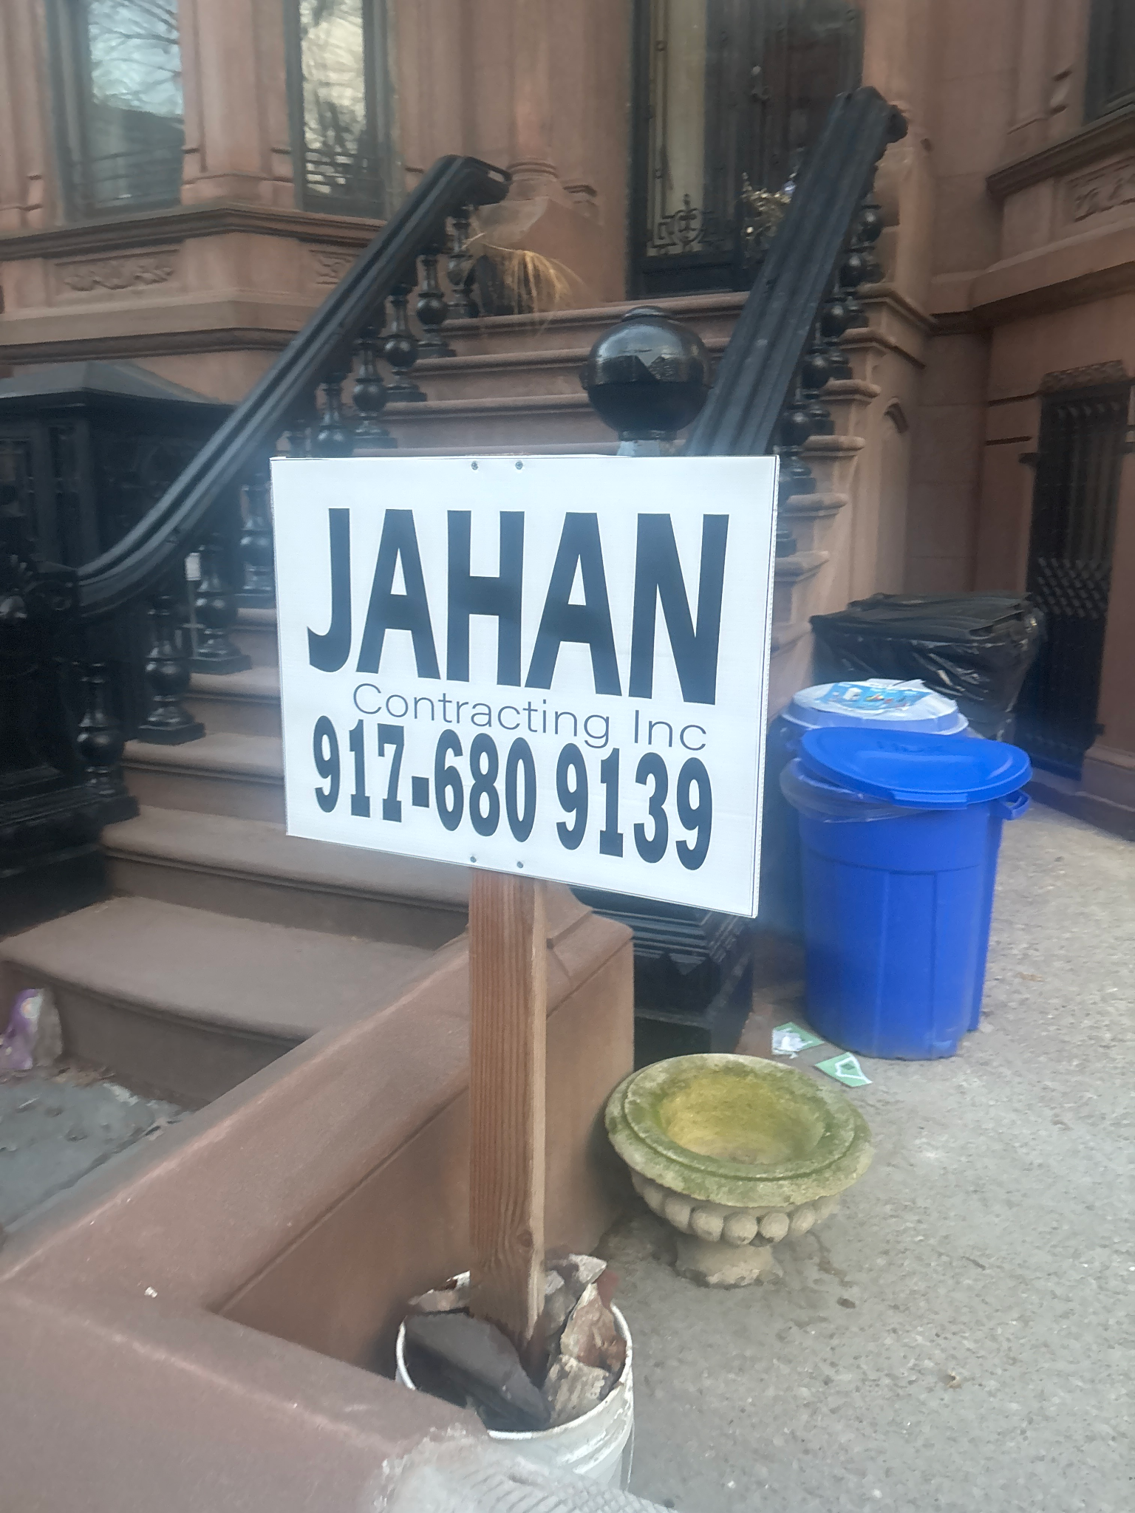

Jahan!
It feels bittersweet to formally say au revoir from a product perspective, but I know we’ll keep in touch with all things voice AI x delivery ops. Thank you SO much for spending so much time enabling me on all things keypad ivr and voice AI - you are patient, knowledgeable, and creative beyond belief.
You made such a big impact on the book ride experience in the VOC and through voice AI! Your legacy will live on forever in all the voice AI prompts ;-)
Wishing you all the luck with leading delivery ops, they are lucky to have you! And of course, on running your contracting business on the side.
Xx Paula

